Slide 1
SEO Strategy for FlinkIt – 10 Minute Grocery Delivery
Presented by :- Rishita Dattani

Slide 2
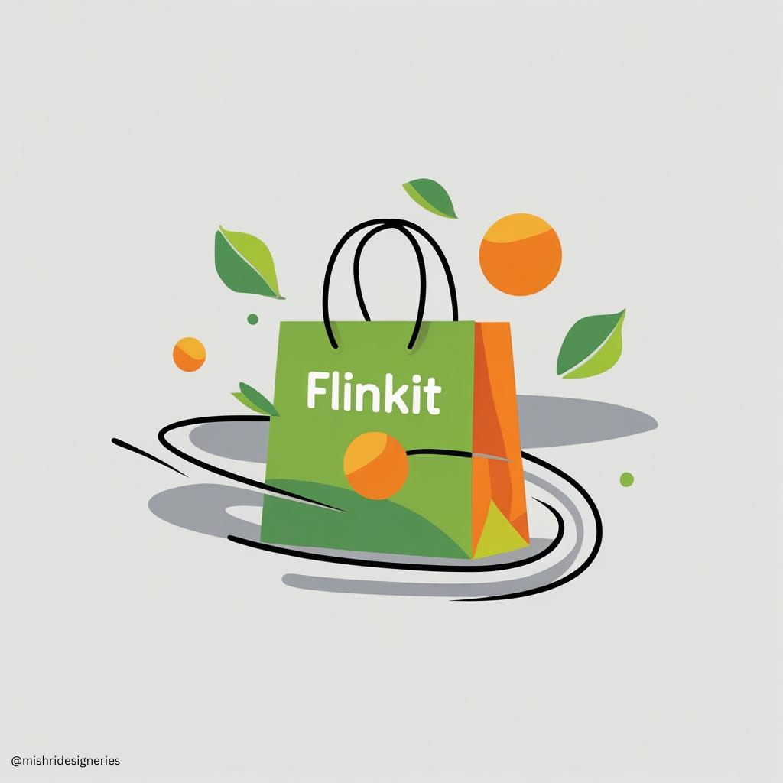
Introduction to FlinkIt
About FlinkIt: FlinkIt is a new Indian startup that promises to deliver groceries in just 10 minutes, focusing on speed, convenience, and quality.
Mission: To revolutionize grocery shopping in India by making it faster, easier, and stress-free for every household.
Vision: To become the most trusted and preferred online grocery delivery platform in India.
Unique Selling Point (USP):
Ultra-fast 10-minute delivery.
Wide range of fresh groceries & essentials.
Affordable pricing & discounts.
Seamless app and website experience.
Target Audience: Busy professionals, working parents, students, and urban households who value time and convenience.

Slide 3
Problem Statement
In India’s fast-paced urban lifestyle, people often find traditional grocery shopping time-consuming and inconvenient. Long queues, traffic, and limited store timings make it difficult for working professionals, students, and families.
While online grocery platforms exist, many customers complain about delayed deliveries, limited product availability, and lack of trust in product freshness.
Urban consumers today demand speed, reliability, and convenience from grocery delivery services.
Being a new startup, FlinkIt struggles with low brand awareness and poor online visibility compared to established competitors like Blinkit, Zepto, and BigBasket.
To attract and retain customers, FlinkIt must optimize its website, rank higher on Google search results, and build a strong SEO-driven presence.

Slide 4
Objective
The main objective of FlinkIt’s SEO strategy is to build a strong digital presence and increase visibility on search engines. As a new grocery delivery startup, FlinkIt aims to rank higher on Google search results, attract organic traffic, and create awareness about its unique promise of 10-minute delivery. Through an optimized website structure, keyword-targeted content, and effective on-page SEO practices, the goal is to drive more visitors, convert them into customers, and establish FlinkIt as a reliable and competitive player in the Indian grocery delivery market.

Slide 5
Approach
FlinkIt will follow a step-by-step SEO strategy that begins with creating a user-friendly website structure to ensure smooth navigation for customers and easy crawling for search engines. The plan includes identifying the right blog topics, product pages, and category pages, and building well-organized content around them. Each page will be optimized with targeted keywords, meta tags, and on-page elements to strengthen the overall ranking potential.
A detailed competitive analysis will be conducted to study existing players like Blinkit, Zepto, and BigBasket. By identifying their top-performing pages, keyword gaps, and strengths, FlinkIt will create unique, content-rich pages that focus on user intent and local SEO. With engaging blogs, optimized product descriptions, and category pages, the strategy aims to build brand trust, increase organic reach, and convert visitors into customers.

Slide 6
Website Structure – FlinkIt
Home Page
About Us
Services
Product Category
Fruits and Vegetables
Blog
Blog 1 :- Top 10 Benefits of online grocery shopping in India
Contact Us
10 – minute delivery promise
Offer and Discount
Product Page Example – Mangoes
Dairy and Bakery
Beverages
Household Essentials
Blog 2 :- Why 10 – minute delivery is Changing India Shopping Habits
FAQs
Get in touch via phone, email or in-app chat for quick support
Answer to common queries about delivery, time, product freshness and payment options.

Slide 7
Topic Ideas – FlinkIt
Blog Topics:
Top 10 Benefits of Online Grocery Shopping in India
Product Pages
Why 10-Minute Delivery is Changing Indian Shopping Habits
How FlinkIt Ensures Freshness in Every Order
Tips to Save Time with Online Grocery Delivery
Healthy Eating Made Easy with FlinkIt
Amul Milk 1L – Fresh & Fast Delivery
Fresh Mangoes – Delivered in 10 Minutes
Packaged Juices – Fruit Freshness Guaranteed
Whole Wheat Bread – Daily Bakery Essentials
Butter & Cheese – Dairy Essentials Online
Product Category Pages
Fruits & Vegetables
Dairy & Bakery
Beverages
Household Essentials
Snacks & Packaged Foods

Slide 8
Selected Pages for SEO Optimization
Blog Page
Purpose: Drive organic traffic, educate users, and target high-intent keywords like “online grocery shopping” and “10-minute delivery”.
Product Page
Purpose: Showcase a high-demand product, optimize for purchase-focused keywords, and improve conversion rates.
Product Category Page
Purpose: Organize related products under a single SEO-friendly page, improving internal linking and navigation.
Advantage: Blogs improve brand authority and attract long-tail searches.
Advantage: Strong product pages help in ranking for local & transactional searches.
Advantage: Helps users find multiple products easily and increases the chances of bulk purchase

Slide 9
Content Structure – FlinkIt
1. Blog Page – Top 10 Benefits of Online Grocery Shopping in India
Title / H1: Top 10 Benefits of Online Grocery Shopping in India
Intro Paragraph: Briefly introduce the concept of online grocery shopping and FlinkIt’s 10-minute delivery promise.
Subheadings / H2:
Convenience & Time-Saving
Wide Product Range
Freshness & Quality
Easy Payment Options
Special Offers & Discounts
Conclusion / CTA: Encourage readers to download the app or order online.
2. Product Page – Fresh Mangoes – Delivered in 10 Minutes
Title / H1: Fresh Mangoes – Fast Delivery in 10 Minutes
Images: High-quality product images, alt text included
Description: Product details, freshness, price, nutritional info
Customer Reviews & Ratings
CTA: “Add to Cart” / “Buy Now” button
3. Category Page – Dairy & Bakery Essentials
Title / H1: Dairy & Bakery Essentials – Fresh & Fast Delivery
Subcategories / H2: Milk, Cheese, Butter, Bread, Cakes
Product Listings: Product image, name, price, rating
Filters / Sorting Options: Brand, price, offers
CTA: “Shop Now” / “Add All to Cart”

Slide 10
Competitive Analysis – FlinkIt
Objective: Understand the strengths, weaknesses,
and opportunities by analyzing top competitors
in the 10-minute grocery delivery space.
Competitors Analyzed:
Blinkit – Established ultra-fast grocery delivery brand.
Zepto – Strong focus on youth audience and speed.
BigBasket – Large inventory, strong brand, ranks for
general grocery searches.
Top Pages:
Blinkit: Homepage, Fruits & Vegetables, Offers Page
Zepto: Homepage, Blog (Delivery Benefits), Product Pages
BigBasket: Category Pages (Dairy, Snacks), Popular Product Pages
Top Ranking Keywords:
10-minute grocery delivery
Online grocery shopping India
Buy milk online
Fresh vegetables near me
Strengths:
Strong brand recognition
High domain authority
App-based loyalty programs
Weaknesses / Opportunities for FlinkIt:
Competitors have limited SEO-focused blogs → FlinkIt can target long-tail content.
Local SEO for city-specific delivery is underutilized.
Personalized product pages & category optimization can attract more customers.

Slide 11
Keyword Research – FlinkIt
Short-Tail Keywords (High Volume – Competitive): Grocery delivery, Online grocery shopping, 10-minute delivery, Fresh vegetables online.
Long-Tail Keywords (Medium Volume – Less Competitive): Best online grocery delivery app in India, Buy dairy products online in Rajkot, Order fruits and vegetables at midnight, Fastest online grocery delivery service near me.
Local SEO Keywords (City / Area Based): Grocery delivery in Vadodara, Online grocery in Surat, Quick delivery grocery store in Ahmedabad, 10-minute delivery service near me.
Blog / Informational Keywords: Benefits of online grocery shopping, How 10-minute grocery delivery works, Online grocery vs supermarket shopping, Tips for saving money on online groceries.

Slide 12
On-Page SEO Elements for FlinkIt Website
Objective: Optimize each page of the FlinkIt website for better rankings, higher clicks, and improved user experience.
Meta Tags Optimization : Meta Title: Include primary keyword + brand name Example: “10-Minute Grocery Delivery in Surat | FlinkIt”, Meta Description: Short, keyword-rich, action-oriented (150–160 chars).
URL Structure : Use clean, keyword-friendly URLs. Example - www.flinkit.com/surat/grocery-delivery
Header Tags (H1, H2, H3): H1: Page’s main keyword (e.g., “Online Grocery Delivery in Ahmedabad”) , H2 / H3: Subtopics like benefits, offers, product categories.
Internal Linking : Link blogs → category pages → product pages, Example: A blog on “Benefits of Online Grocery Shopping” links to the “Vegetables” page.
Image Optimization : Use compressed images for speed, Add alt text with keywords (e.g., “fresh fruits online delivery”).
Mobile-Friendly Layout : Since 70% of traffic comes from mobile apps/websites, ensure responsive design.

Slide 13
Example Blog
On-Page SEO Elements for Blog :-
Meta Title: Online Grocery Delivery in India – The Future of Shopping | FlinkIt
Meta Description: Discover why online grocery delivery is booming in India. Learn about convenience, time-saving, and FlinkIt’s 10-minute grocery delivery service.
URL: www.flinkit.com/blog/online-grocery-delivery-future-india
H1 (Main Heading): Why Online Grocery Delivery is the Future of Shopping in India
H2 (Sub-Headings):
Convenience and Time-Saving Benefits
Rise of 10-Minute Delivery Apps in India
Why FlinkIt Stands Out from Competitors
Keywords Targeted:
Online grocery delivery India
Grocery delivery app
10-minute grocery delivery
Future of online shopping
FlinkIt grocery delivery
Design Tip:
Use a blog-style mockup design (like a screenshot preview).
Place H1, H2, Meta Title, Meta Description in callout boxes around it.

Slide 14
Blog Content
Why Online Grocery Delivery is the Future of Shopping in India
The way Indians shop for daily essentials is changing rapidly. With busy lifestyles, traffic issues, and the growing importance of convenience, online grocery delivery in India has emerged as the ultimate solution. Instead of standing in long queues or rushing to nearby stores, customers can now order fresh fruits, vegetables, and household items with just a few clicks.
One of the biggest revolutions in this space is the concept of 10-minute grocery delivery. Startups like FlinkIt are making it possible to get groceries delivered faster than it takes to brew a cup of tea. This instant delivery not only saves time but also ensures that consumers never have to compromise on freshness or quality.

Slide 15
Blog Content - Continued
Another key reason behind the rising popularity of grocery delivery apps is affordability. Online platforms often provide discounts, cashback offers, and loyalty programs, making them more budget-friendly than traditional stores. For families, students, and working professionals, this combination of savings and speed makes online grocery shopping highly attractive.
Looking ahead, the future of online shopping in India is set to be dominated by the grocery segment. With advanced technology, better logistics, and wider product availability, customers can expect faster service and more personalized experiences.
At FlinkIt, our mission is simple: to make grocery shopping stress-free and ultra-fast. Whether you need daily vegetables, fresh dairy products, or pantry staples, FlinkIt ensures they reach your doorstep within minutes. With reliability, quality, and unmatched speed, FlinkIt is setting a new benchmark for the future of online grocery delivery in India.

Slide 16
On-Page Elements for Blog
Meta Title: Online Grocery Delivery in India – The Future of Shopping | FlinkIt
Meta Description: Learn how 10-minute grocery delivery apps like FlinkIt are transforming shopping in India. Explore the benefits of online grocery delivery.
Keywords Used: online grocery delivery India, grocery delivery app, 10-minute grocery delivery, future of online shopping, FlinkIt grocery delivery.

Slide 17
Conclusion & Takeaways
Conclusion
Online grocery delivery is shaping the future of shopping in India. With speed, convenience, and affordability, FlinkIt is well-positioned to lead the 10-minute grocery delivery market. A strong SEO strategy ensures better visibility, traffic, and customer trust.
Key Takeaways
Clear Website Structure improves navigation & SEO.
Keyword-Rich Content boosts authority and rankings.
On-Page SEO (titles, headers, meta tags, links) drives visibility.
Competitor Insights highlight gaps & growth opportunities.

